Slide 1

Dynamic Variable Threshold Method for Ice Freeze-up & Breakup detection
Sam Yu

Slide 2
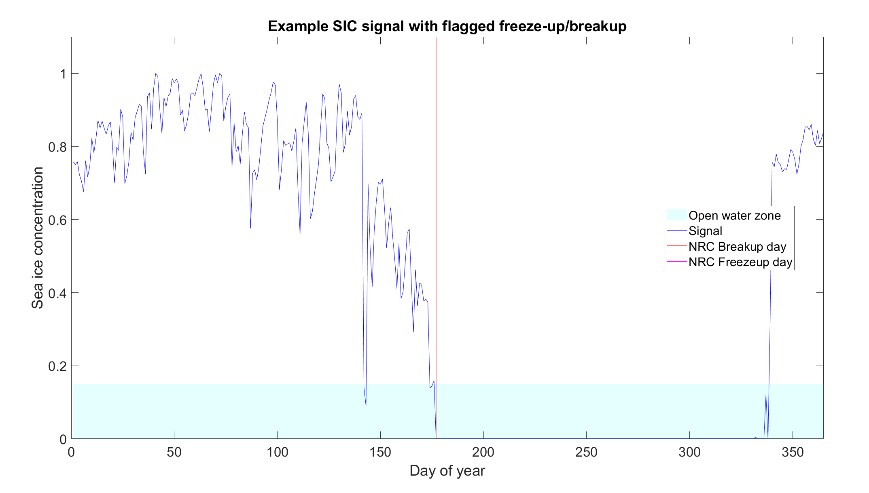
NRC Definition of Freeze-up/Breakup
We are interested in key dates in the yearly ice cycle, particularly when the ice melts (breakup) or water freezes (freeze-up)
Given a sea ice concentration (SIC) time-series at a location,
The NRC definitions for freeze-up/breakup are as follows:
NRC Breakup date definition: First day that we observe 15 days of continuous open water (SIC < 0.15)
NRC Freeze-up date definition: First day that we observe 15 days of continuous ice (SIC > 0.15)

Slide 3
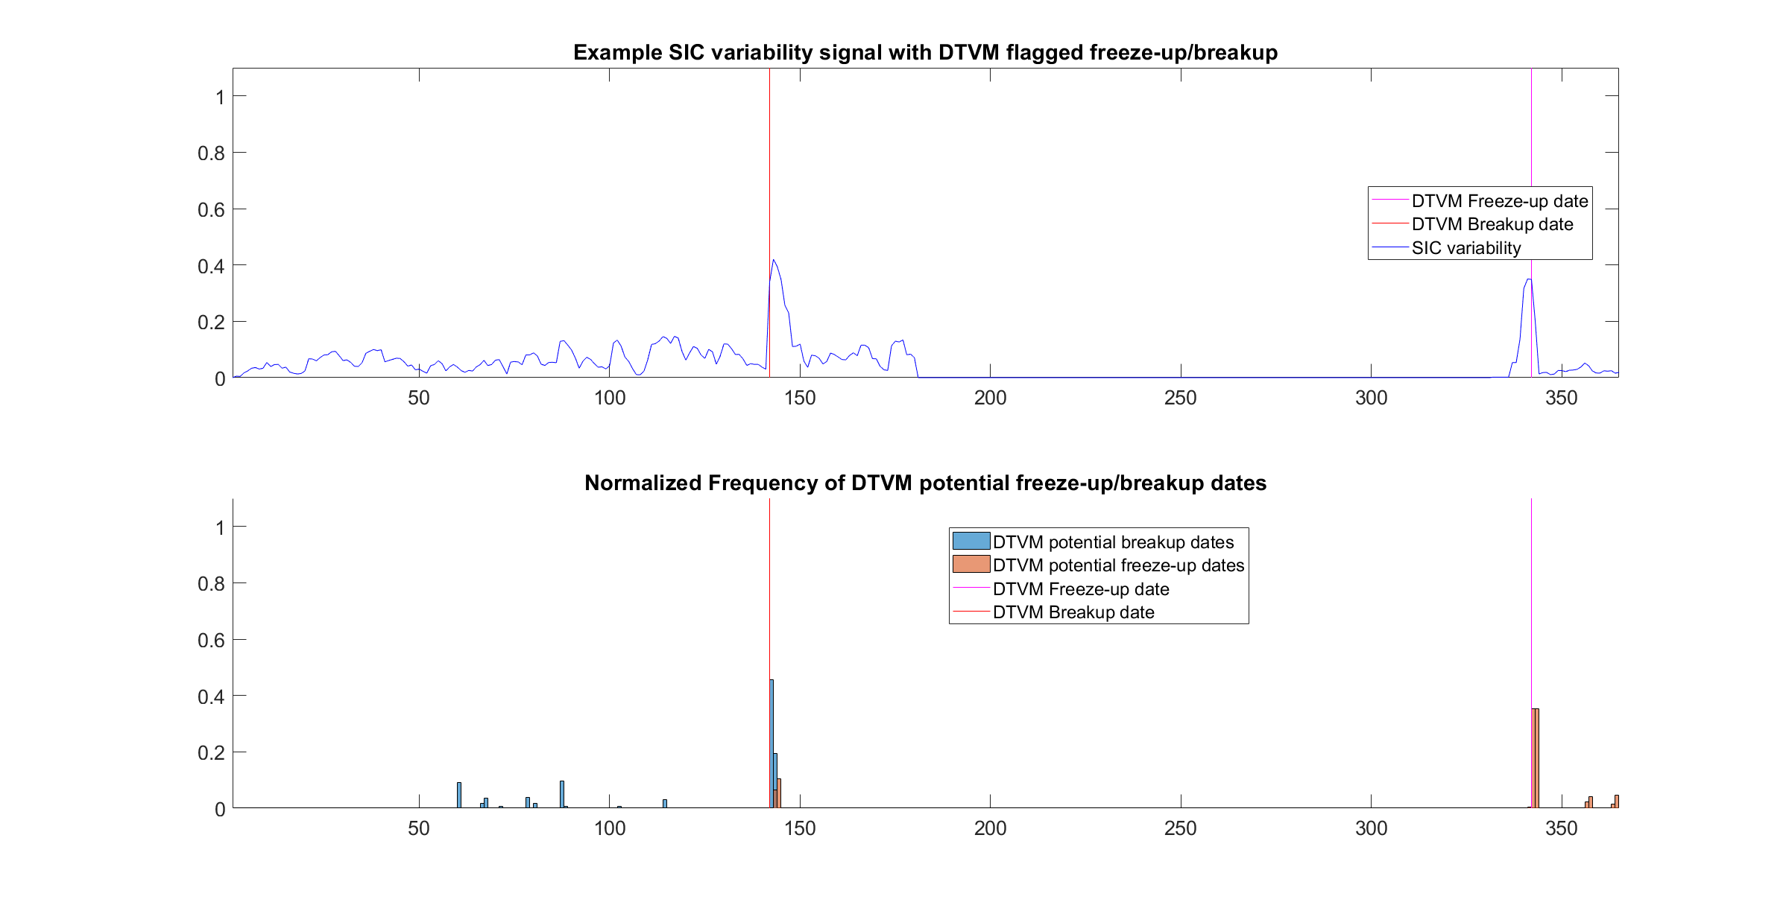
Overview of DTVM algorithm
New idea:
Ice breakup/freeze-up is correlated with the variability of the ice concentration signal at location
Calculate the moving standard deviation of the sea ice concentration (SIC) signal to obtain a variability signal
Generate a range of threshold values between 0 and maximum of variability signal
For each threshold value:
Breakup: count forwards from day 1 and assign a potential breakup date as the first day that the variability crosses the threshold from above
Freeze-up: count backwards from day 365 and assign a potential freeze-up date as the first day that the variability crosses the threshold from above
Define the DTVM breakup date as the 75th percentile of the potential breakup dates. Similarly, define the DTVM freeze-up date as the 25th percentile of the potential freeze-up dates.

Slide 4
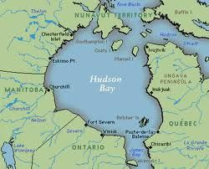
Additional Details
Two preprocessing approaches used:
Raw:
No preprocessing done to SIC signal except interpolating NaN values
Binarized + Filtered:
SIC signal is binarized with a threshold value of 0.15 and a 5th order median filter is applied to smooth signal and remove spurious spikes. Example of median filtering:
Input signal: Output signal:
2 | 3 | 4 | 10 | 3 | 2 | 3
2 | 3 | 3 | 3 | 3 | 3 | 2
Hudson region:
Foxe Basin
Hudson Strait
James Bay
East Coast
Baffin Sea
Optimal NRC Window maps:
Calculate NRC Freeze-up/breakup dates using a range of window values: e.g. 5-30
For each location: find window value that yields the closest date to DTVM date
Plot a color map of optimal window values

Slide 5
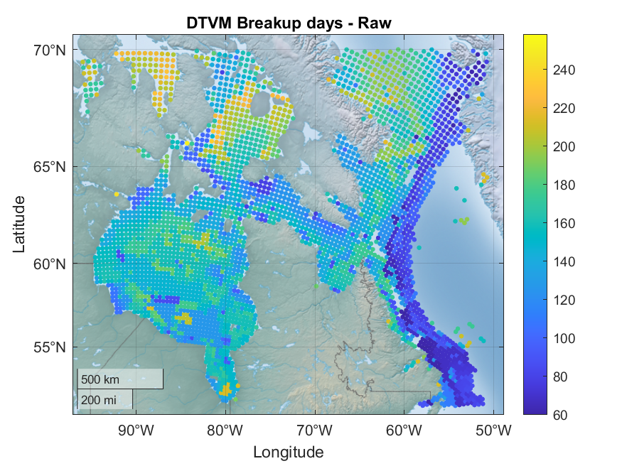
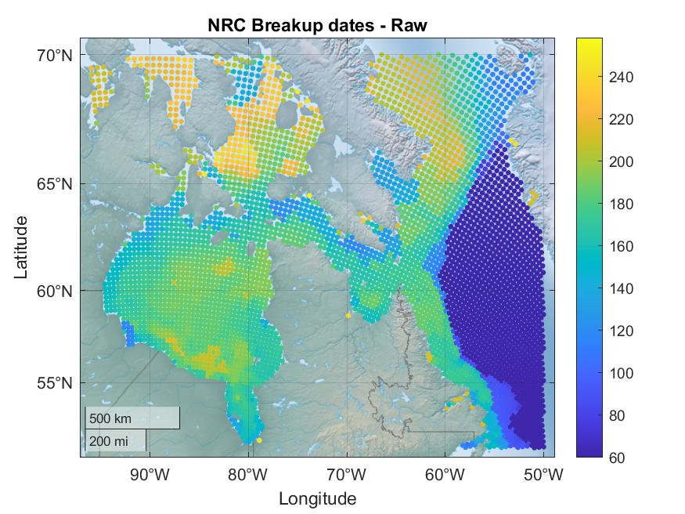
2007 Hudson – Breakup date maps (Raw)

Slide 6
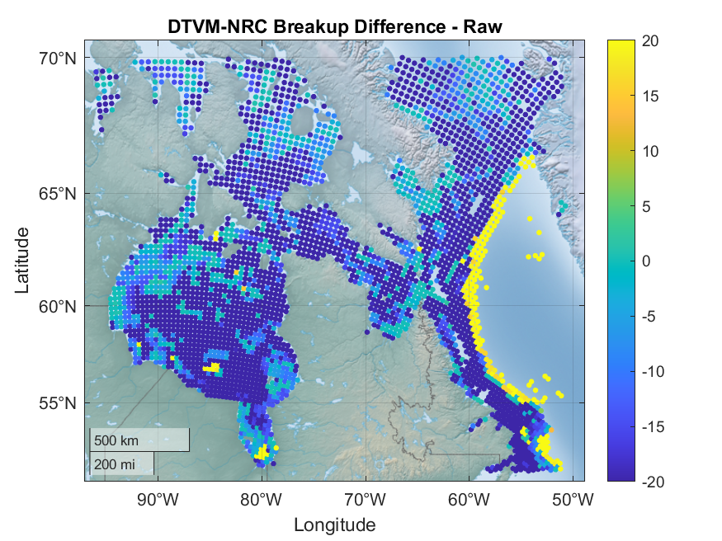
2007 Hudson – Breakup differences (Raw)

Slide 7
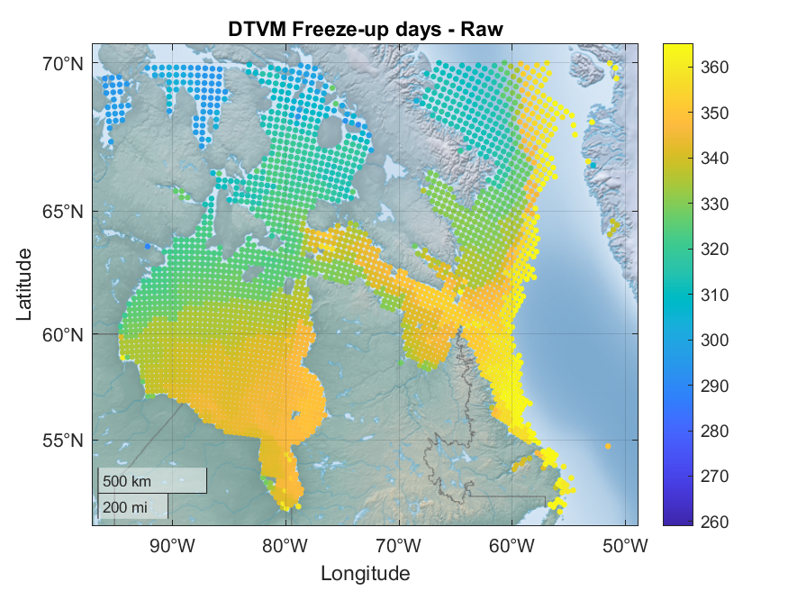
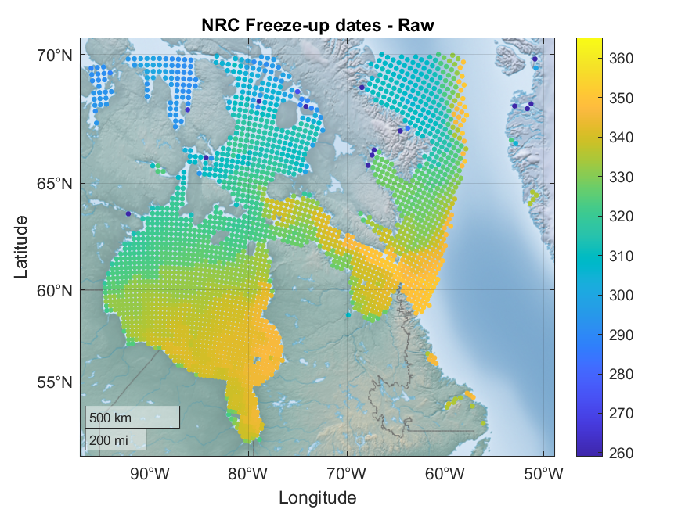
2007 Hudson – Freeze-up date maps (Raw)

Slide 8
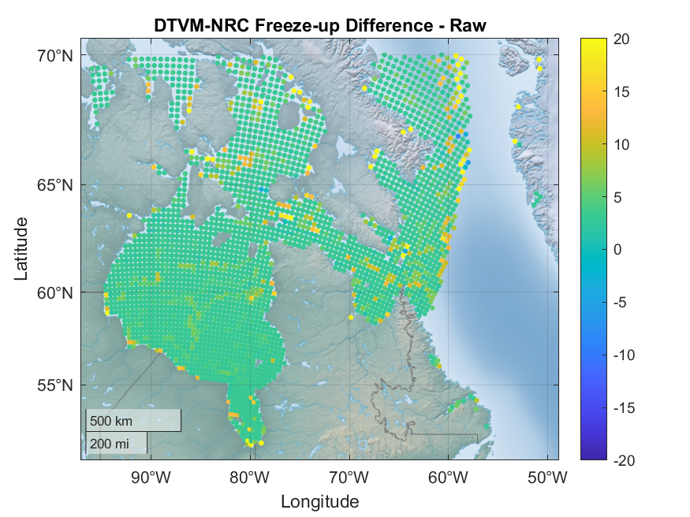
2007 Hudson – Freeze-up differences (Raw)

Slide 9
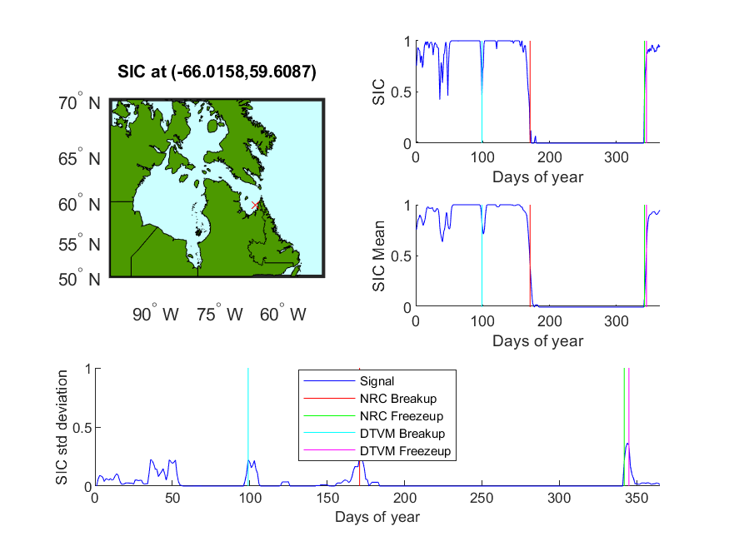
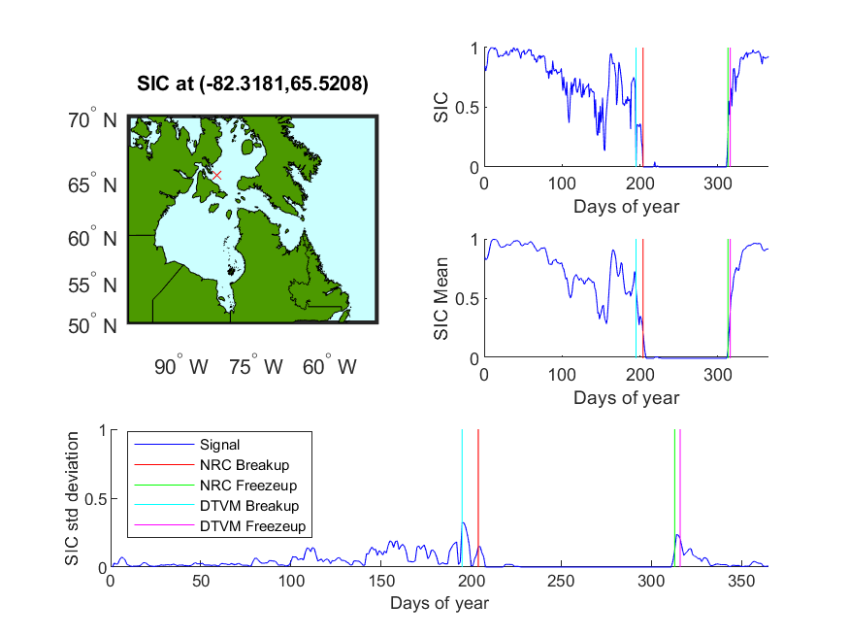
2007 – Example points in Hudson Strait/Foxe Basin (Raw)

Slide 10
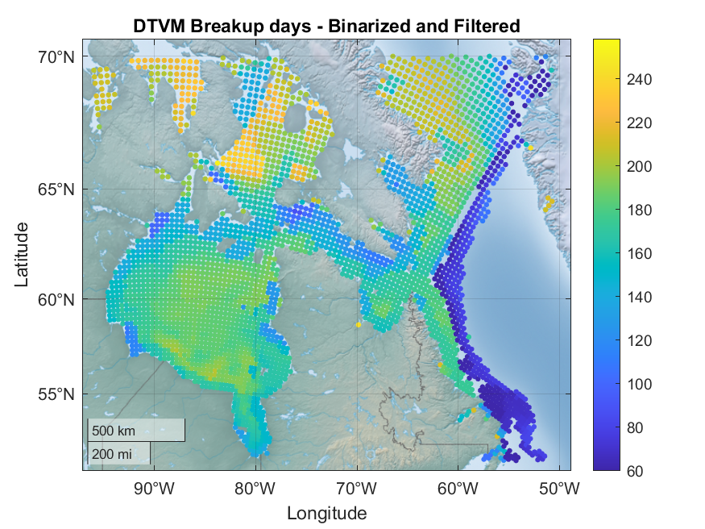

2007 Hudson - Breakup maps (Binarized + Filtered)

Slide 11
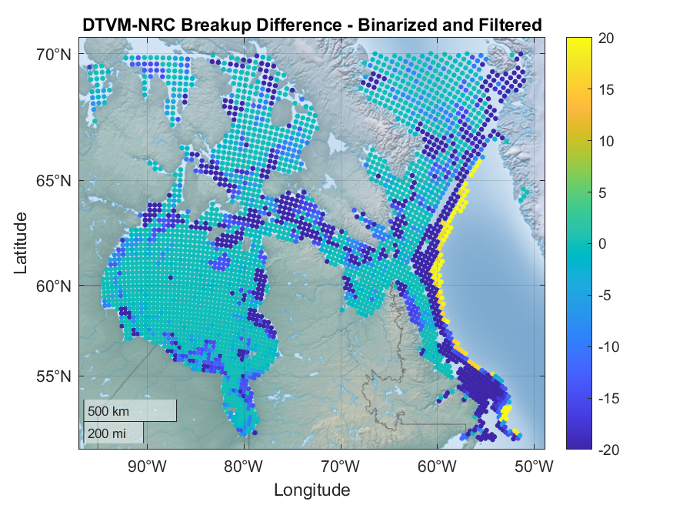
2007 Hudson – Breakup differences (Binarized + Filtered)

Slide 12
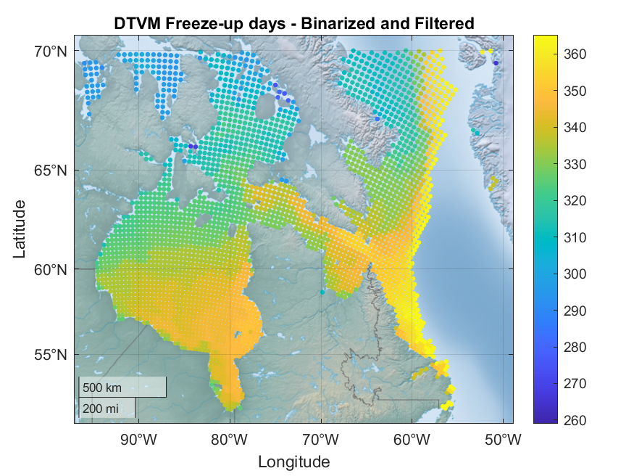

2007 Hudson – Freezeup maps (Binarized + Filtered)

Slide 13
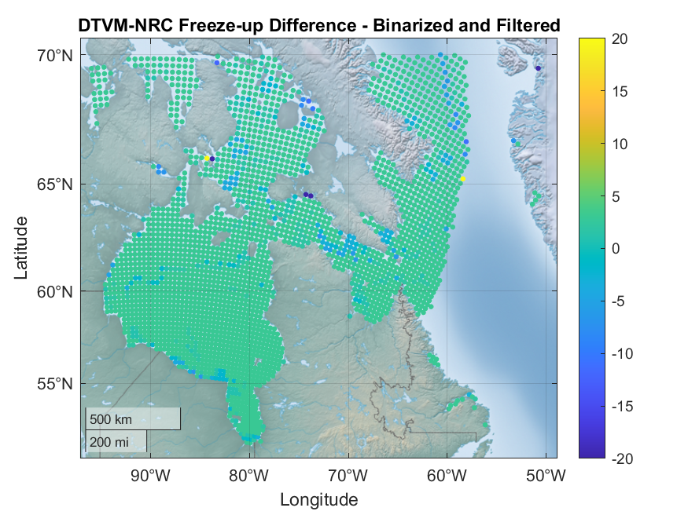
2007 Hudson – Freeze-up differences (Binarized + Filtered)

Slide 14
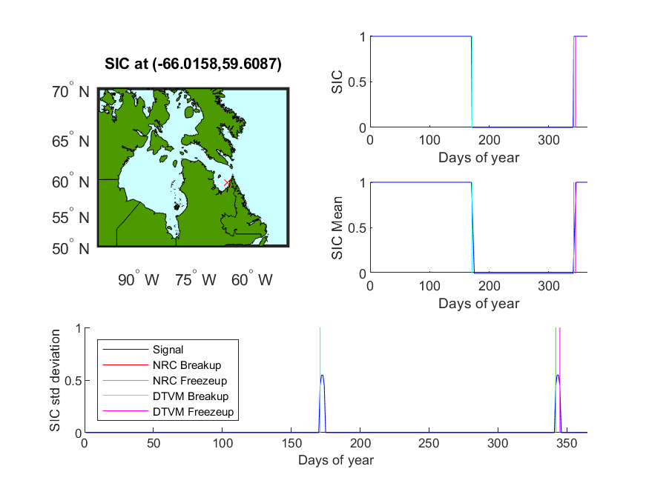

2007 Hudson – Example points in Hudson Strait/Foxe Basin (Binarized + Filtered)

Slide 15
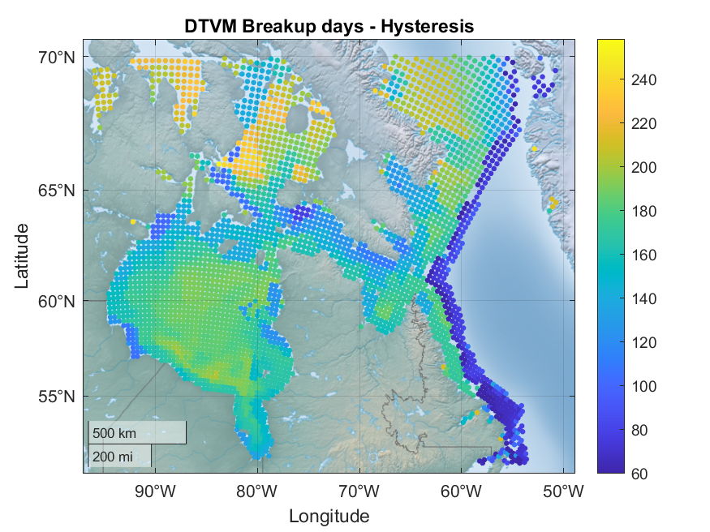

2007 Hudson – Breakup date maps (Hysteresis)

Slide 16
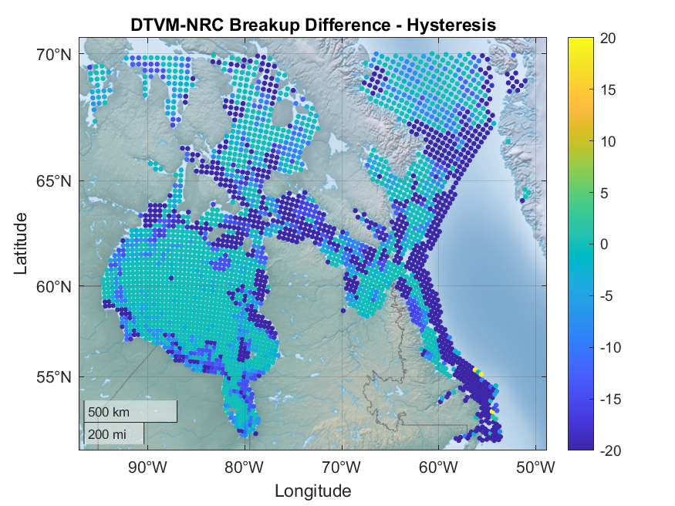
2007 Hudson – Breakup differences (Hysteresis)

Slide 17
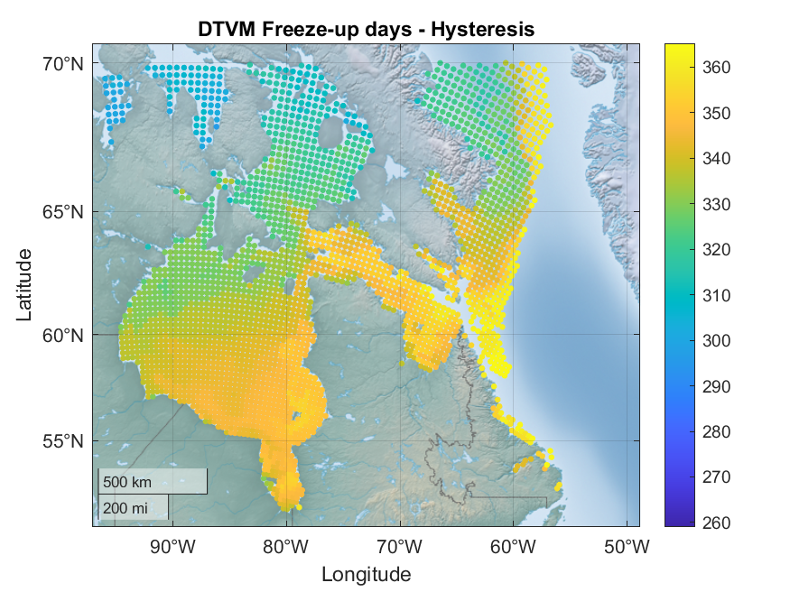
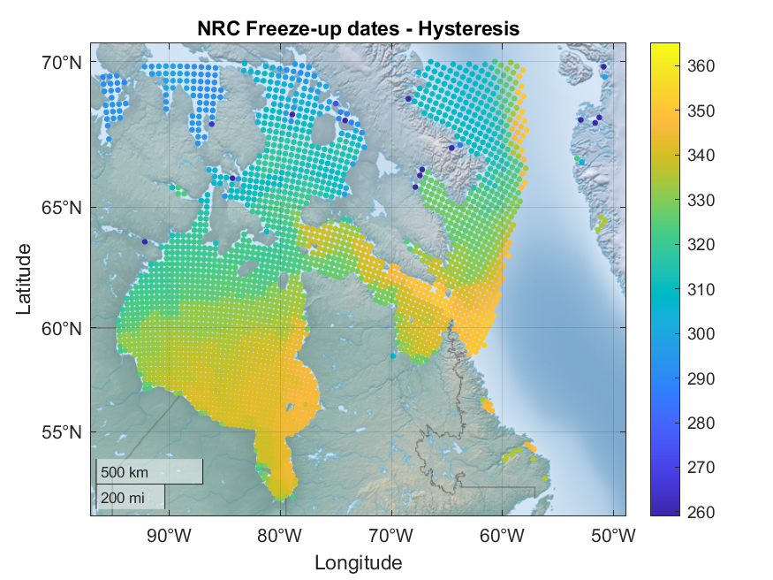
2007 Hudson – Freeze-up date maps (Hysteresis)

Slide 18
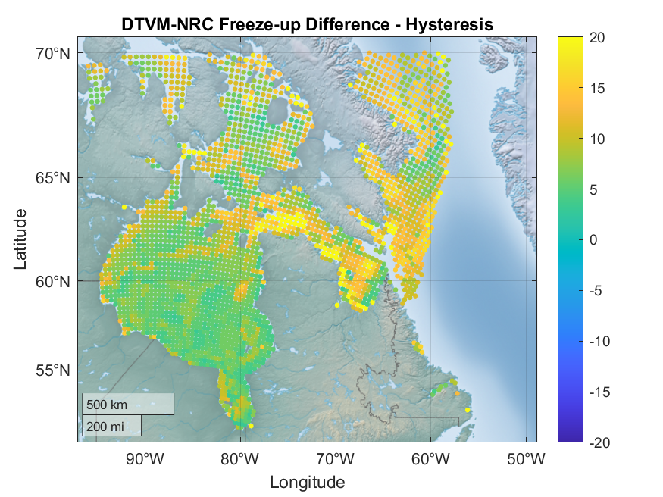
2007 Hudson – Freeze-up differences (Hysteresis)

Slide 19
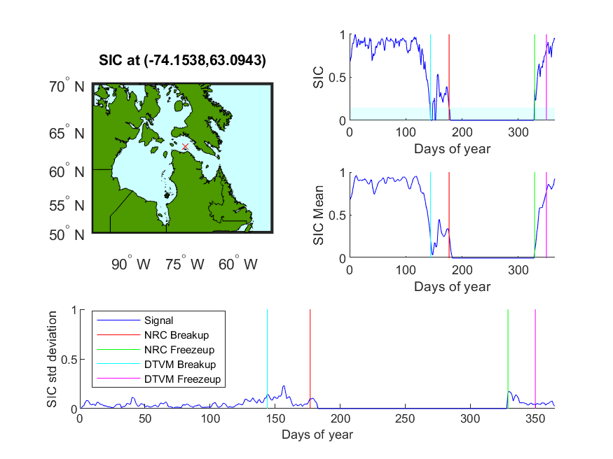
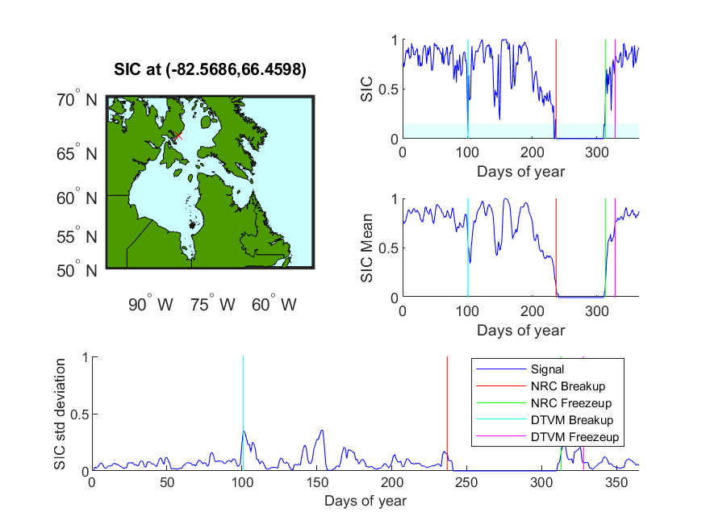
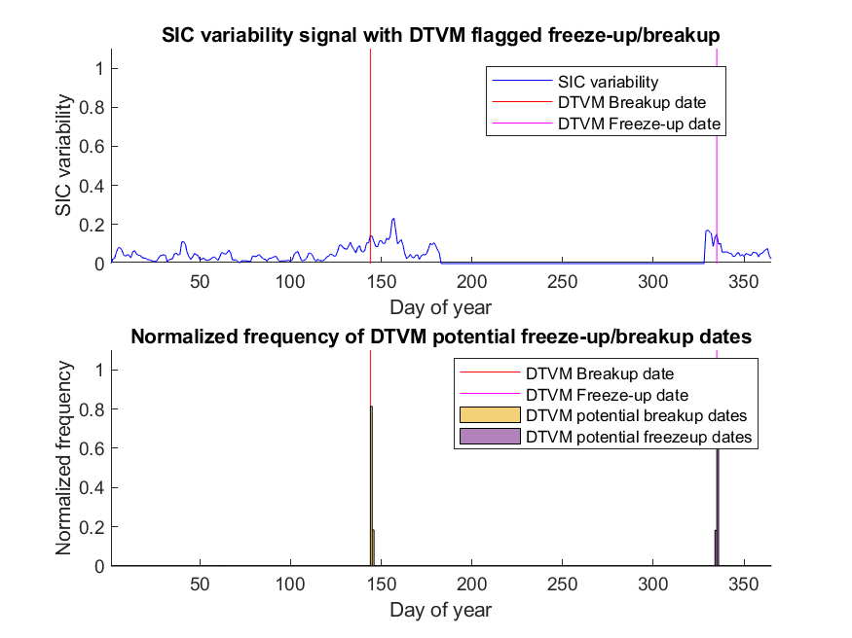
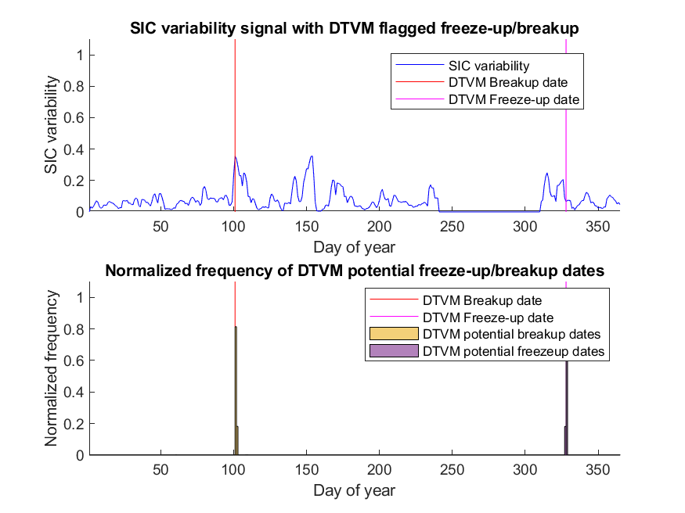
2007 Hudson – Example points in Hudson Strait/Foxe Basin (Hysteresis)

Slide 20
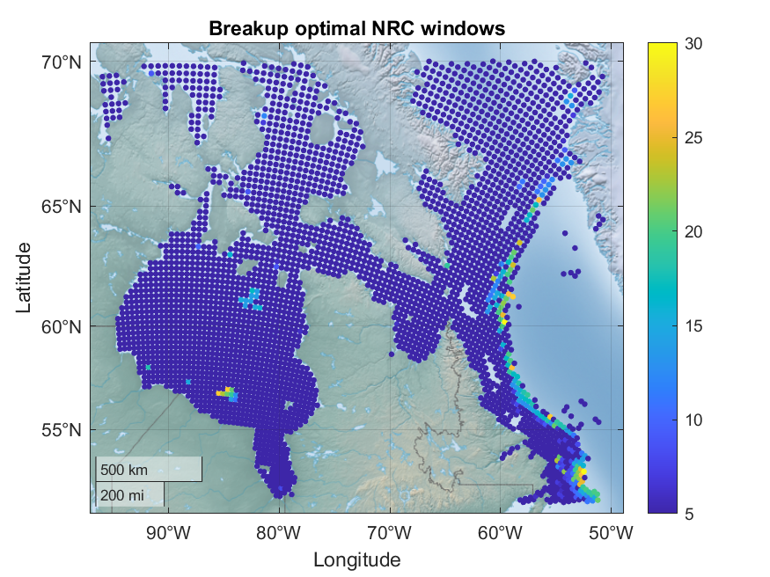
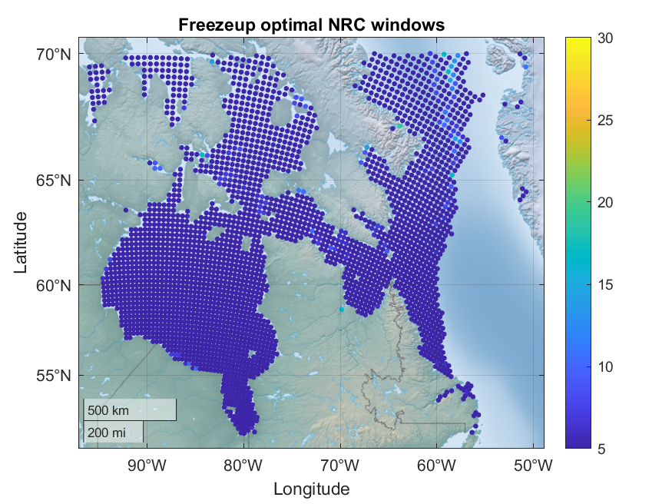
2007 – Map of optimal NRC window values
Using window values ranging from 5 to 30:
Finding: an NRC window value of 10 has the best agreement with DTVM

Slide 21
Next steps…
Generate sets of DTVM outputs for datasets from different years/regions:
Maps of freeze-up/breakup dates for DTVM/NRC
Optimal window maps
New data sources: ESACCI 2008, 2009, 2010

